Slide 1
Python Data Types
- Kavita Tewani

Slide 2
Standard Data Types
Python has five standard data types:
Numbers
String
List
Tuple
Dictionary

Slide 3
Numbers
int
All integers in Python3 are represented as long integers. Hence there is no separate number type as long.
Integers in Python 3 are of unlimited size.
float
A floating-point number is accurate up to 15 decimal places

Slide 4
Complex
A complex number consists of an ordered pair of real floating-point numbers denoted by x + yj, where x and y are the real numbers and j is the imaginary unit.

Slide 5
int | float | complex
10 | 0.0 | 3.14j
100 | 15.20 | 45.j
-786 | -21.9 | 9.322e1-36j
0o70 | 32.3e18 | .876j
-0o470 | -90. | -.6545+0J
-0x260 | -32.54e100 | 3e1+26J
0x69 | 70.2E-12 | 4.53e1-7j

Slide 6
Strings
Strings in Python are identified as a contiguous set of characters represented in the quotation marks.
Python allows for either pairs of single or double quotes.
Subsets of strings can be taken using the slice operator ([ ] and [:] ) with indexes starting at 0 in the beginning of the string and working their way from -1 at the end.
The plus (+) sign is the string concatenation operator and the asterisk (*) is the repetition operator.
Trying to access elements beyond the length of the string results in an error.

Slide 7
Mutable and Immutable in Python
Python represents all its data as objects that has
an identity (id)
a value (mutable or immutable)
Some of these objects like lists and dictionaries are mutable, meaning you can change their content without changing their identity (Mutable)
Other objects like integers, floats, strings and tuples are objects that can not be changed (Immutable). If you change the value, they also change their id.
Some objects are mutable, meaning they can be altered. Others are immutable; they cannot be changed but rather return new objects when attempting to update
Primitive data types are normally immutable while container and user-defined data types are mutable
Immutable objects are fundamentally expensive to "change", because doing so involves creating a copy. Changing mutable objects is cheap

Slide 8
Type Conversion
You can convert from one type to another with the int(), float(), and complex() methods:
Casting in python is therefore done using constructor functions:
int() - constructs an integer number from an integer literal, a float literal (by rounding down to the previous whole number), or a string literal (providing the string represents a whole number)
float() - constructs a float number from an integer literal, a float literal or a string literal (providing the string represents a float or an integer)
str() - constructs a string from a wide variety of data types, including strings, integer literals and float literals

Slide 9
Python has the following data types built-in by default, in these categories:
Text Type: str
Numeric Types: int, float, complex
Sequence Types: list, tuple, range
Mapping Type: dict
Set Types: set, frozenset
Boolean Type: bool
Binary Types: bytes, bytearray, memoryview

Slide 10
List
A list contains items separated by commas and enclosed within square brackets ([]).
To some extent, lists are similar to arrays in C. One difference between them is that all the items belonging to a list can be of different data type.
The values stored in a list can be accessed using the slice operator ([ ] and [:]) with indexes starting at 0 in the beginning of the list and working their way from -1 at the end.
The plus (+) sign is the list concatenation operator, and the asterisk (*) is the repetition operator.
Unlike strings, which are immutable, lists are a mutable type, i.e. it is possible to change their content.
Trying to access/assign elements beyond the length of the list results in an error.

Slide 11
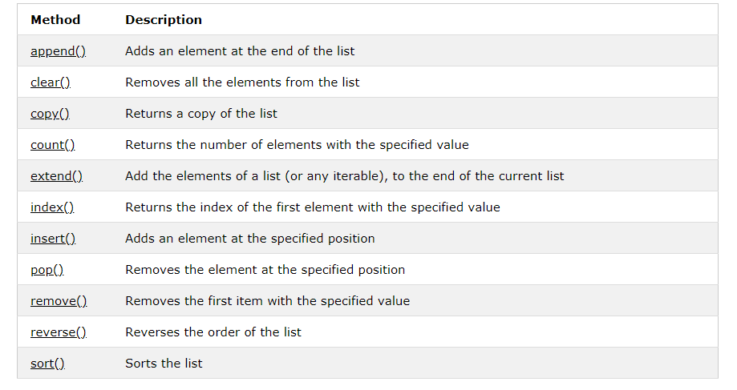
Functions on List

Slide 12
Tuples
A tuple is another sequence data type that is similar to the list.
A tuple consists of a number of values separated by commas.
Unlike lists, however, tuples are enclosed within parentheses.
The main differences between lists and tuples are: Lists are enclosed in brackets ( [ ] ) and their elements and size can be changed, while tuples are enclosed in parentheses ( ( ) ) and cannot be updated.
Tuples can be thought of as read-only lists/immutable lists.

Slide 13
Sets
A set in Mathematics refers to an unordered collection of objects without any duplicate.
An object of type set may be created by enclosing the elements of the sets with in curly brackets.
The major difference is that sets, unlike lists or tuples, cannot have multiple occurrences of the same element and store unordered values.
The set objects may also be created by applying the set function to lists strings and tuples.
Unlike lists we can’t access the elements of a set through indexing and slicing
We cant apply + and * operators on sets

Slide 14
Dictionary
Dictionaries consist of key-value pairs.
A dictionary key can be almost any Python type, but are usually numbers or strings.
Values, on the other hand, can be any arbitrary Python object.
Dictionaries are enclosed by curly braces ({ }) and values can be assigned and accessed using square braces ([]).
Dictionaries have no concept of order among elements.
It is incorrect to say that the elements are "out of order"; they are simply unordered.
Dictionaries are mutable.

Slide 15
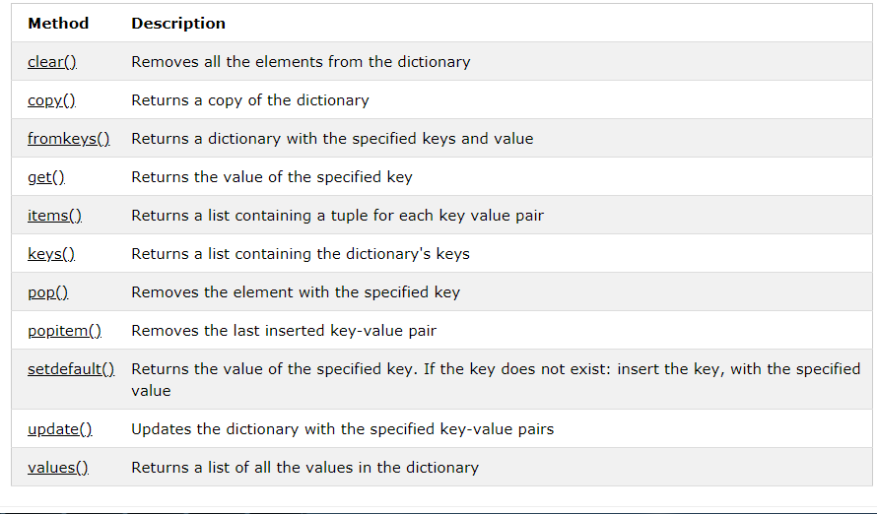
Methods of Dictionary

